Slide 1
MATPLOTLIB

Slide 2
Matplotlib is a graph plotting library in Python that serves as a visualization utility
Matplotlib is open source and we can use it freely, built on NumPy arrays.
One of the greatest benefits of visualization is that it allows us visual access to huge amounts of data with easy visuals
Matplotlib consists of several plots like line, bar, scatter, histogram etc, plots helps to understand trends, patterns, and to make correlations.
Notes:
Data visualization is the process of translating the numbers, text, or large data sets into various types of graphs such as histograms, maps, bar plots, pie chart etc.

Slide 3
Importing matplotlib:
from matplotlib import pyplot as plt or
import matplotlib.pyplot as plt

Slide 4
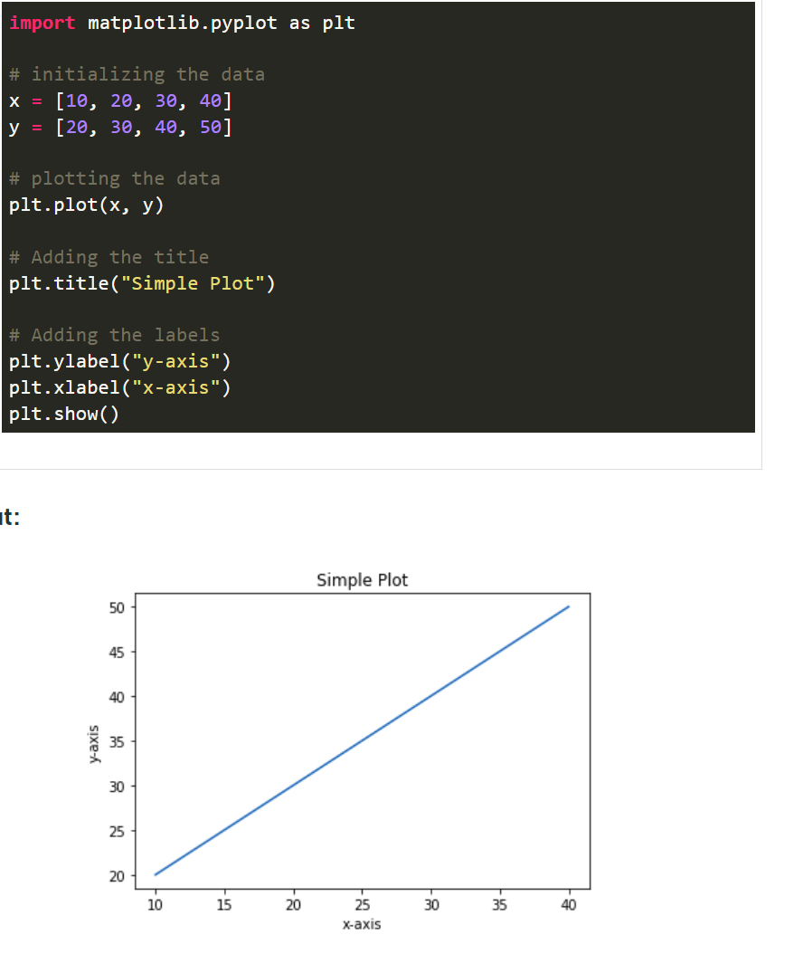
Getting started with PyPlot
PyPlot is a Matplotlib module that provides a MATLAB like interface. PyPlot provides functions that interact with figure i.e. creates a figure, decorates the plot with labels, and creates plotting area in a figure.

Slide 5
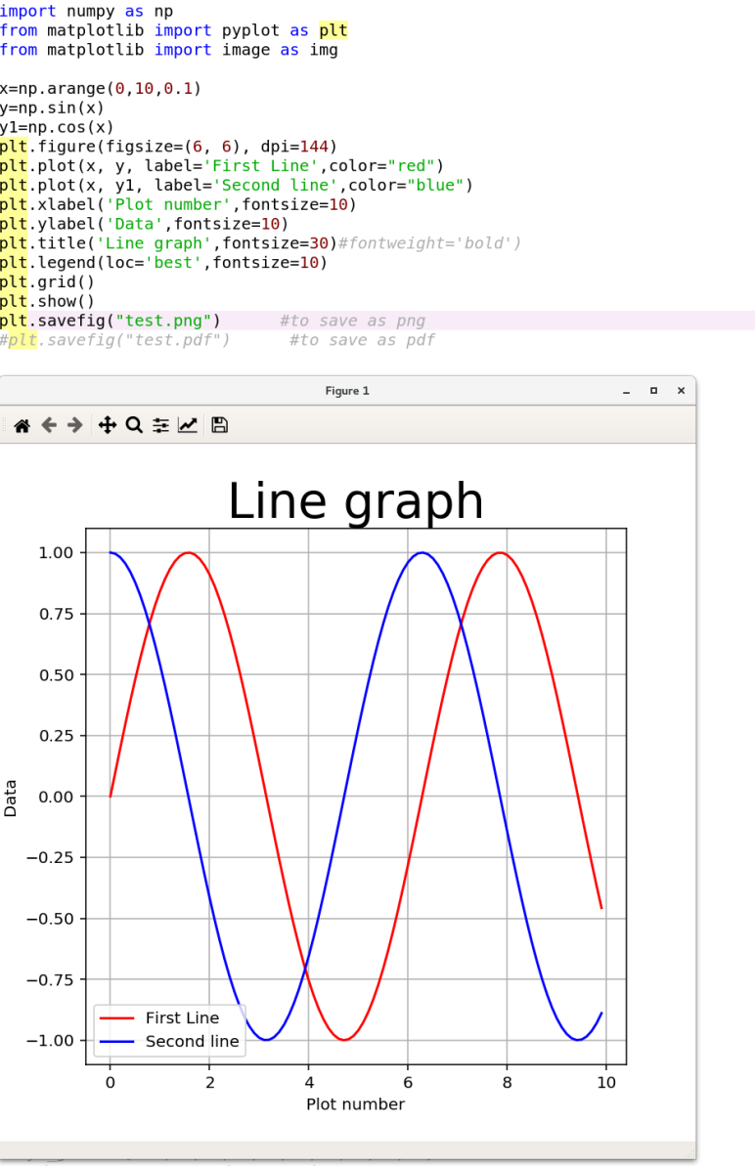
Legends, Titles, Labels, Figsize, DPI
Legends allows us to distinguish between plots. With legends, you can use label texts to identify or differentiate one plot from another

Slide 6
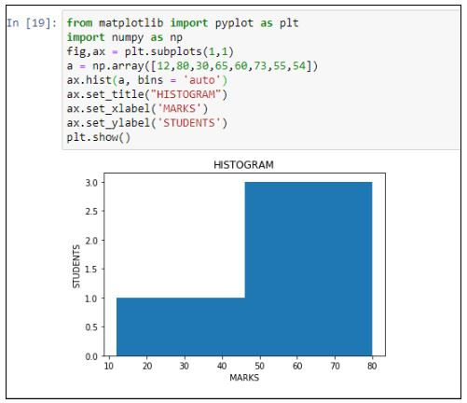
Plot Types
Histogram
Helps us understand the distribution of numeric value in a way that you can not do with mean, median, mode

Slide 7
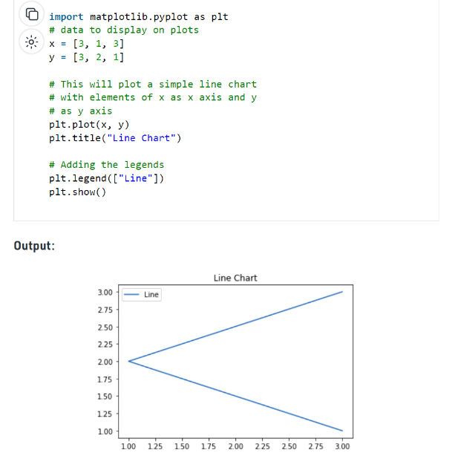
Line Plot
is a chart that shows a trend over a period of time.

Slide 8
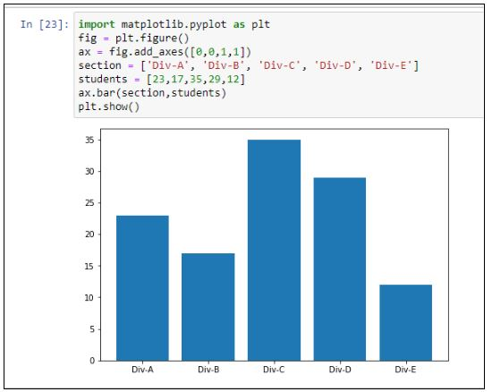
Bar graphs
Are convenient for comparing numeric values of several groups.

Slide 9
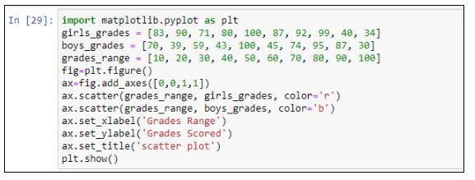
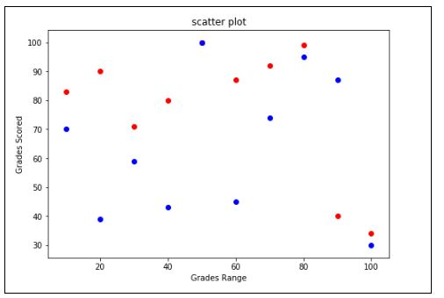
Scatter Plots
Offer a convenient way to visualize how two numeric values are related in your data (correlation)
It helps in understanding relationships between multiple variables.

Slide 10
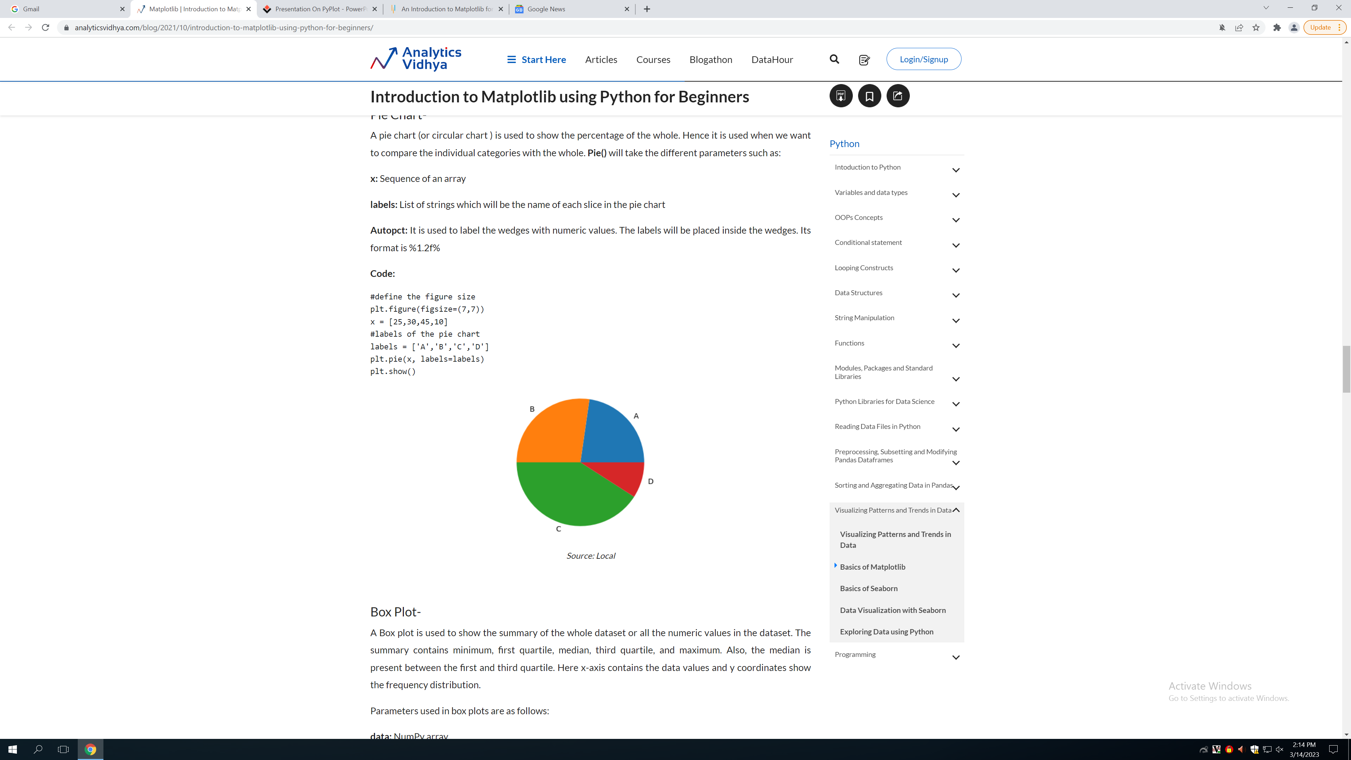
Pie chart
Used when we want to compare the individual categories with whole

Slide 11
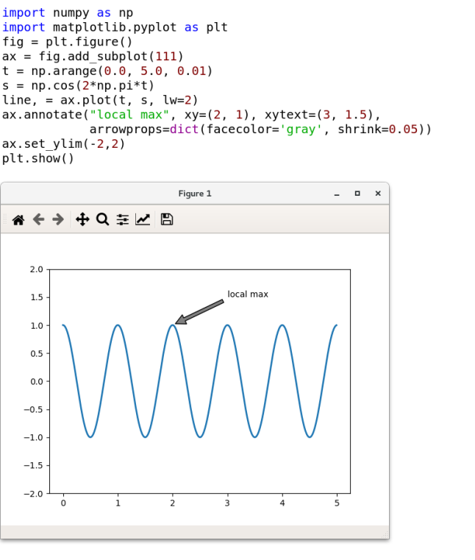
Annotating text in the Plot
Annotations are graphical elements, often pieces of text, that explain, add content to, or highlight some portion of the visualized data.

Slide 12
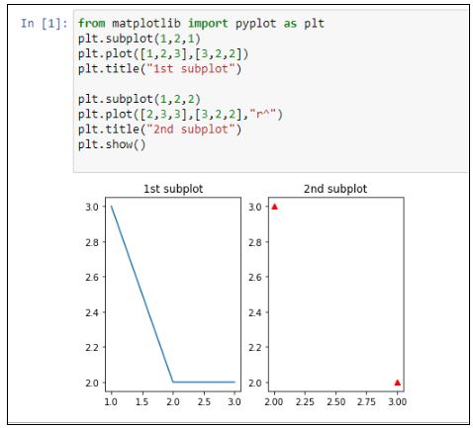
MatPlotlib allows us easily create multi-plots on the same figure using the subplot() method. This subplot() method takes in three parameters, namely:
nrows : the number of rows the figure should have
ncols : the number of columns the figure should have
plot_number : which refers to a specific plot in the figure

Slide 13
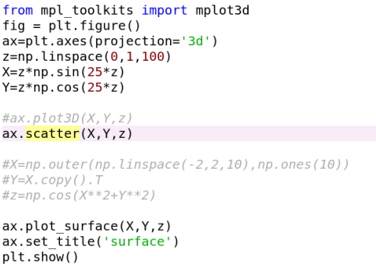
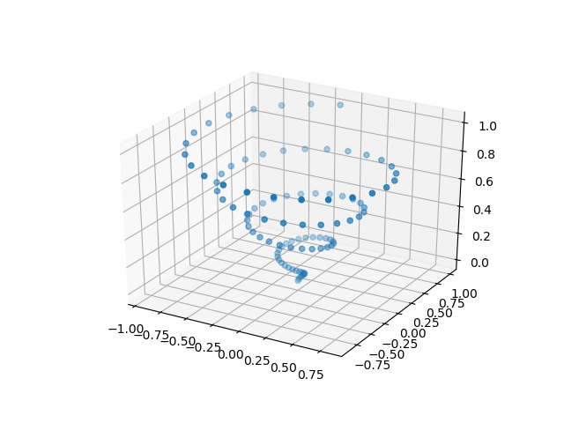
3-D plot

Slide 14
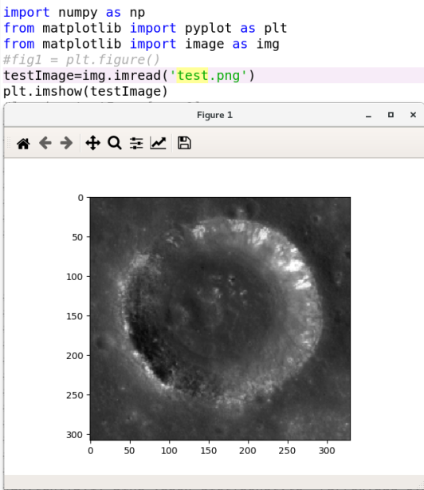
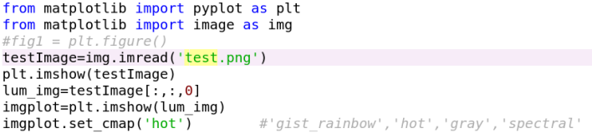
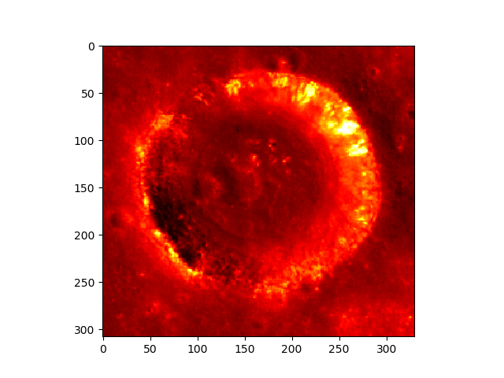
Working with Images
Notes:
You can also plot any numpy array - just remember that the datatype must be float32 (and range from 0.0 to
1.0) or uint8.

